Slide 1

GAMESCAPE :-
GROUP 007
MTH-208
DATA SCIENCE LAB 1-
INSTRUCTOR :-
DR. DOOTIKA VATS
DATA SCRAPING AND ANALYSIS OF THE TOP 250 E-GAMES
USING R

Slide 2


OBJECTIVE
In our project, we have developed an app
that helps users discover the best
games tailored to their interests
Data Collection
Gather comprehensive data on the top 250 most popular e-games, including attributes like player counts, ratings and genres.
Filtering Mechanisms
Visualization
Develop filters to enable users to search and explore games based on criteria such as rank, cost, release year, voting scores, and personal favorites.
Create interactive visual representations to illustrate trends and insights within the gaming landscape, enhancing accessibility and understanding.

Slide 3

ABOUT THE DATA
Following websites were used to extract data :
01
Wikipedia (https://www.wikipedia.org/)
02
Steam Top 250 (https://steam250.com/top250)

Slide 4
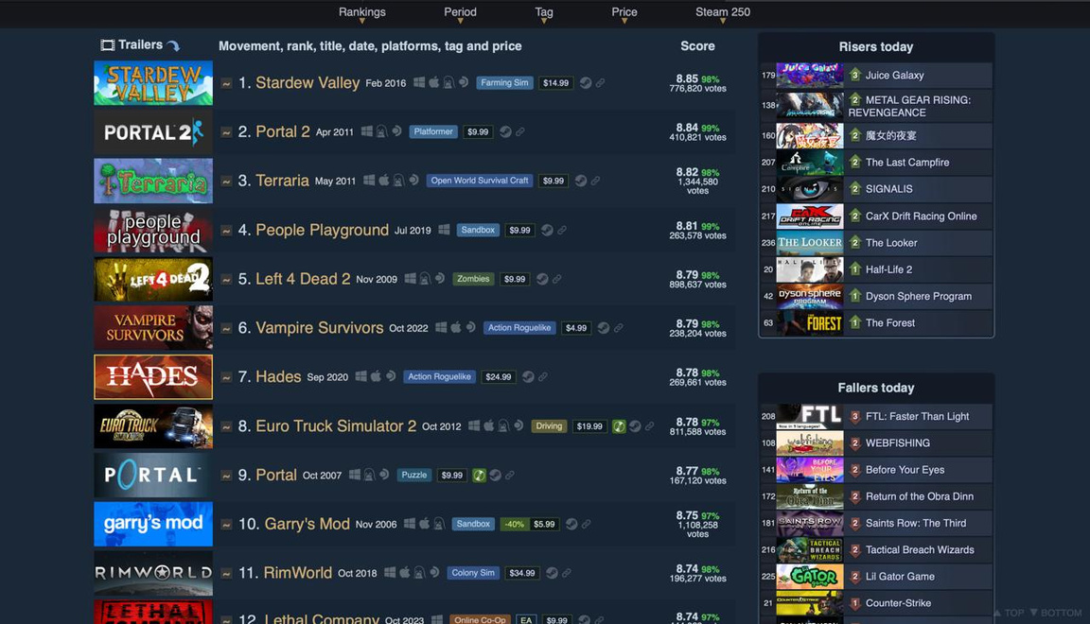
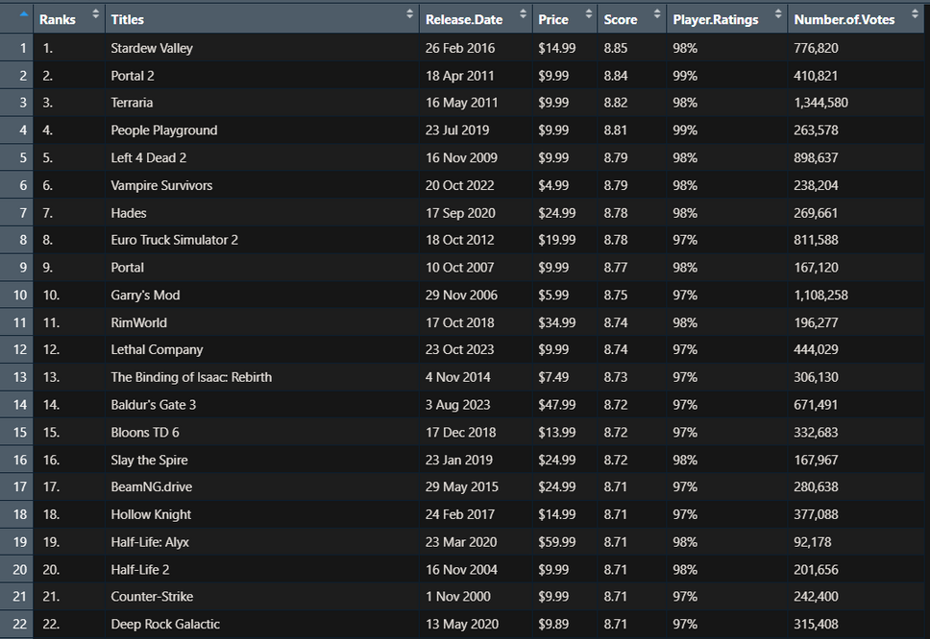
SCRAPING DATA
Using R Libraries
tidyverse and rvest
Cleaned and Formatted
the Data using dplyr

Slide 5

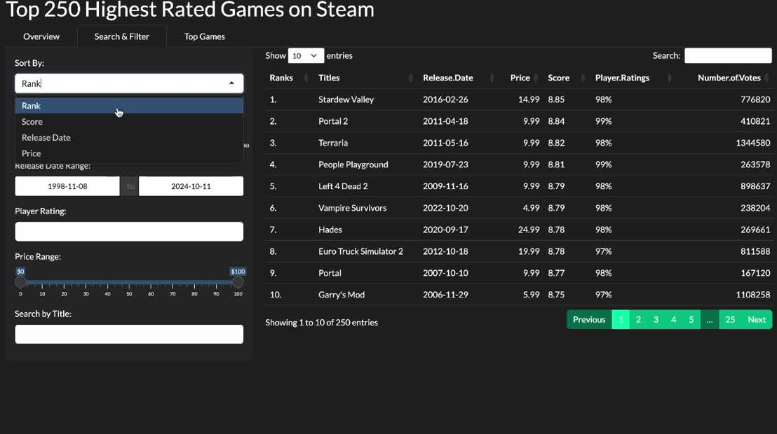
APP OVERVIEW :-

Slide 6



THANK YOU
PROJECT MEMBERS :-
Neelaksha Malik
Mainak Sarkar
Harsh Deep
Tenzin Tsomu

